Slide 1
Bike Store Data Analysis Project
Team Members:
Abhijith S D
Arvind C R
Ayyasamy S
Gurumurthy Kalyanpur Viswanathaiah
Manjunath
SQL Analysis of the BikeStores Database

Slide 2
Project Overview
Objective:
To understand the dataset, uncover underlying patterns, and generate insights that could guide further analysis or decision-making.
Goals:
Select and analyze the BikeStores dataset.
Perform data cleaning and preprocessing.
Conduct data analysis using SQL.
Present findings and insights.

Slide 3
Tools and Platforms used
MySQL Database Server
Robust platform for managing relational databases.
MySQL Workbench
Simplified database design and query execution.
Azure Database Connection
Provided scalable and secure cloud database solutions.
Hex Platform
Enabled collaborative data analysis and visualization.
Github.com
Enabled collaborative code check-ins

Slide 4
Dataset Description
Dataset: BikeStores Database from kaggle.com
Source: Provided SQL schema and data files as csv.
Key Tables: Stores, Staffs, Brands, Categories, Products, Stocks, Customers, Orders, Order Items
Schema Overview:
The database contains information about bike stores, including products, sales, staff, and customers.
Entity Relationships:
Products belong to Brands and Categories.
Customers place Orders, which contain Order Items that reference Products. Orders are managed by Staff and linked to Stores.
Staff work at Stores and may manage other Staff.
Stocks track Products available at Stores.

Slide 5
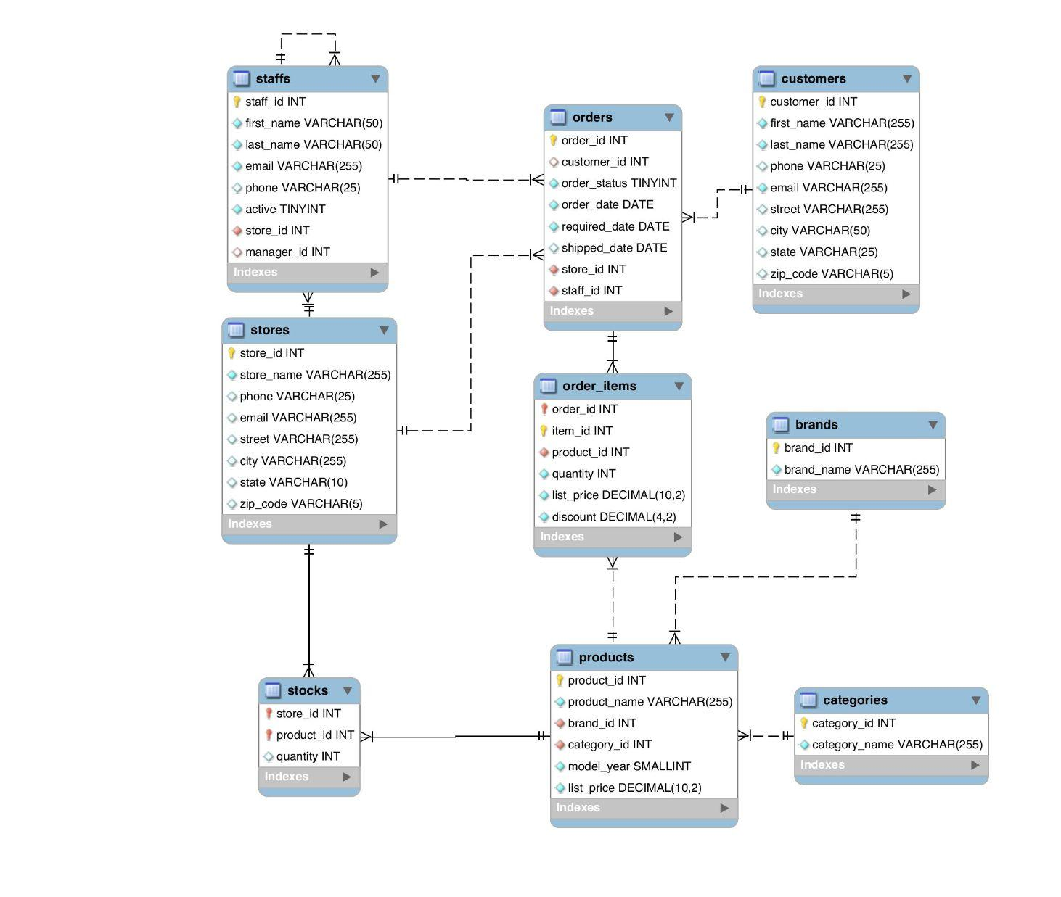
ER Diagram

Slide 6
Data Import and Setup
Environment Setup:
Used MySQL Database Server and MySQL Workbench.
Connected to Azure Database for remote access.
Project Directory:
Created a dedicated directory for the project files.
Included SQL scripts and data files.
Data Import:
Loaded the provided schema and data into the MySQL database.
Ensured all tables and relationships were correctly established.

Slide 7
Data Cleaning
Identified Issues:
Missing phone numbers in customers and staffs tables.
NULL values in shipped_date in orders table.
Actions Taken:
Decided to retain entries with missing phone numbers to preserve data integrity.
Noted the missing shipped_date values for consideration in shipping time analysis.
Rationale:
Retaining records ensures a comprehensive analysis.
Missing values can inform about data collection processes and areas for improvement.

Slide 8
Descriptive Statistics
Total Number of Orders:
Unique Order Statuses: Order Status Mapping: 1: Pending, 2: Processing, 3: Rejected, 4: Completed
Order Status counts:
Total Sales by Product Category:
Products per Category and Brand:

Slide 9
Aggregation, grouping, joins
Customer order analysis:
Staff performance:

Slide 10
Subqueries and CTEs
Identifying Low Stock Products:

Slide 11
Advanced SQL Functions
Calculating Running Total of Sale
Year-over-Year Sales Growth:

Slide 12
Insights and Conclusions
Key Findings:
Top Products: Trek Slash 8 27.5 - 2016 is the highest revenue-generating product.
Customer Behavior: High concentration of sales among top customers.
Inventory Management: Some products have critically low stock levels.
Staff Allocation: Baldwin Bikes store appears understaffed given its high sales volume.
Conclusions:
Inventory: Need to replenish low-stock items promptly.
Marketing: Opportunity to expand offerings for underrepresented brands.
Staffing: Consider reallocating staff to balance workload and improve customer service.

Slide 13
Recommendations
Inventory Strategies:
Implement automated alerts for low stock levels.
Analyze sales trends for better demand forecasting.
Customer Engagement:
Develop loyalty programs for top customers.
Personalized marketing based on purchasing behavior.
Staff Development:
Provide training for staff in high-performing stores.
Reassess staffing needs based on store performance.
Data Quality Improvement:
Encourage capturing complete customer information (e.g., phone numbers).
Address data gaps in shipping dates for accurate delivery analysis.

Slide 14
Next Steps
Further Analysis:
Deep dive into seasonal sales trends.
Customer segmentation analysis.
Product return and refund patterns.
Business Actions:
Enhance product line based on customer preferences.
Optimize supply chain for faster deliveries.
Technical Improvements:
Implement data validation rules to improve data quality.
Integrate dashboards for real-time monitoring.

